Slide 1
THERMOFORMING PROCESS

Slide 2
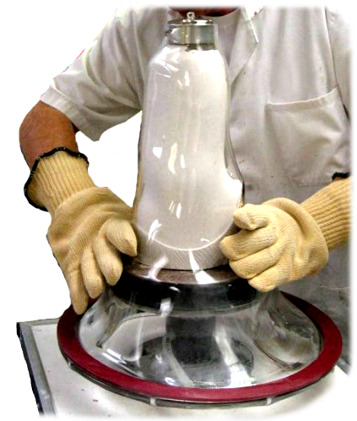
These instructions are for the
Crystal Clear Ringmaster only.
For separate instructions for the colored plastic, please view appropriate presentation.
Notes:
What separates the Ringmaster from the rest is the patented metal ring formed into the outer edge plastic.
This will simplify and shorten the time needed, in addition to reducing the cost of your check socket fabrication.
Injected molded from the inside to the outside

Slide 3
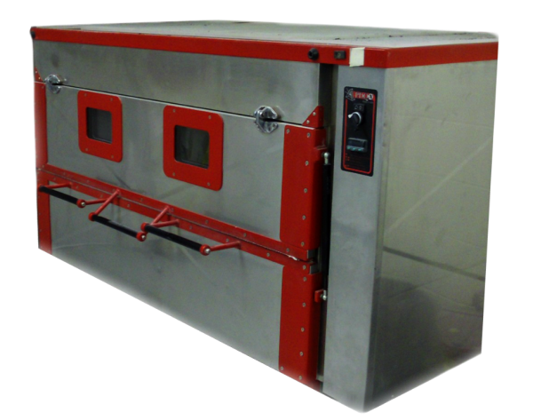
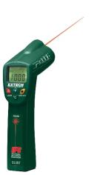
Pre-heat the oven to 365° F or 185 C°
Remember, no two ovens are alike. If you are having any issues with your oven, the easiest way to figure out if your oven is working correctly is by using a non-contact thermometer. Using the non contact thermometer you can test for cool spots in the plastic and if your oven is not heating uniformly.
365° Fahrenheit
185° Celsius
STEP
1

Slide 4
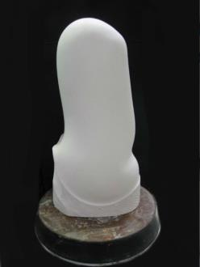
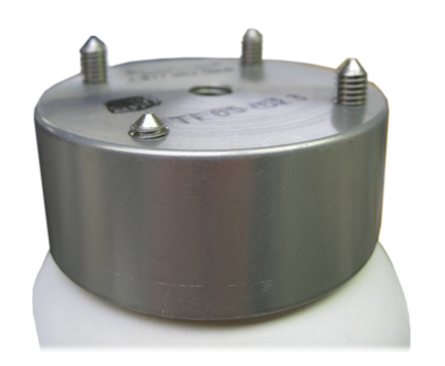
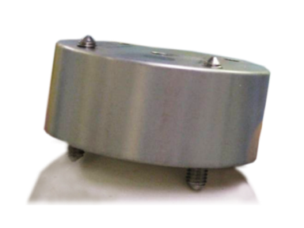
Prepare positive model by setting up fixture on distal end (such as TF-65) Be sure not to leave the spikes too high, and use plaster to blend the edges. Perform regular prep on positive model.
Options for securing your dummy include spikes, posts, putty, or plaster. Hammer it on!
Too
High
OK
STEP
2
TIP! We recommend using a second set of spikes on the underside of the dummy instead of a post, so the dummy won’t slip when you’re twisting the plastic as you form.

Slide 5
A brand new item that can also be used is the removable center spike TF-RCS. You can take the center spike and drill in into the center of model and then screw the dummy right onto the top
Pictured here with TF-65
Click here to view website listing for TF-RCS

Slide 6
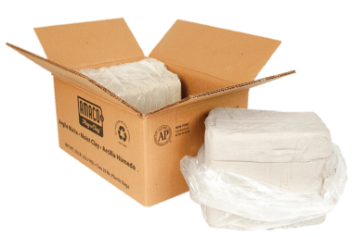
Grab your putty! You want to make sure the putty provides a smooth transition between the dummy and the model or you’ll have a tough time getting the dummy out of the socket after you pull it.
You also want to make sure no putty is left on the body of the metal dummy, this could cause the lock to fit loosely.
STEP
3

Slide 7
Let’s talk vacuum.
Some people like to use a block underneath the mold. If so, make sure it has a hole in it to allow for suction.

Slide 8
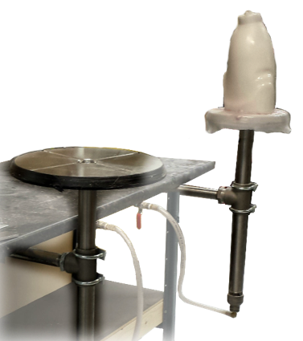
BULLDOG has grooved vacuum forming plates with channels cut into it them.
Available in 10” (fits 12” ringmaster) 12” (fits 16” ringmaster) 14” (fits 20” ringmaster)
And our new size 17”, this plate does not have grooves.

Slide 9
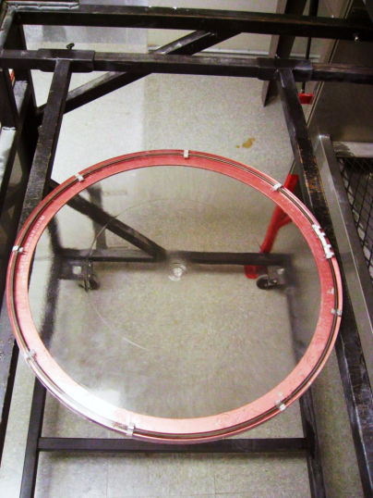
Place Ringmaster® sheet on the aluminum support ring with the spru facing downward.
TIP: You can use one red ring on the bottom, but a 2nd one on top is even better.
STEP
4

Slide 10
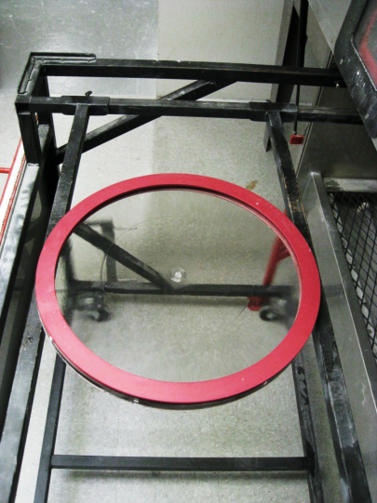
Place second aluminum support ring (RM-AS) on top centered with plastic.
STEP
4

Slide 11
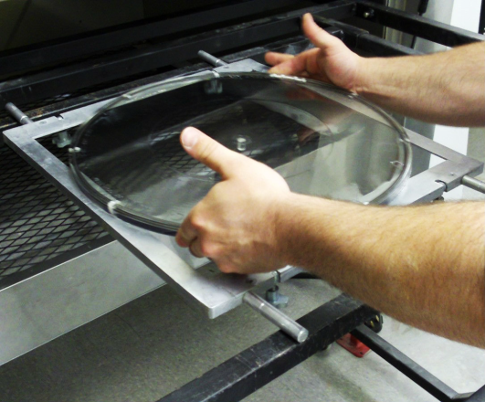
In a pinch you can use a square frame.
STEP
4

Slide 12
NEVER LAY THE RING DIRECTLY ON THE ADJUSTABLE ARMS.
IT MUST BE SUPPORTED ON AT LEAST 4 SIDES.
STEP
4

Slide 13
Or, of course, you can put the plastic on the Ringmaster® stand when using an oven without arms.
STEP
4

Slide 14
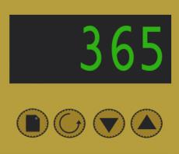
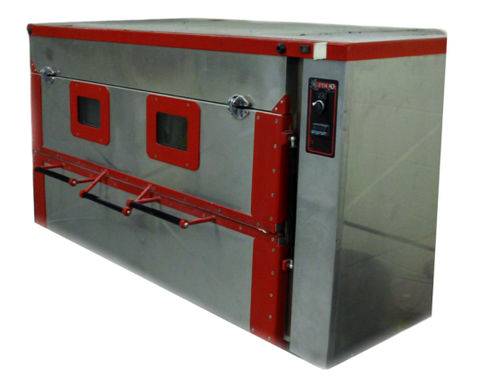
15 Minutes.
Heat the plastic inside the oven for approximately 15 minutes at 365° Fahrenheit.
STEP
5
TIP! No two ovens are alike. Depending on how your oven heats there may be heating inconsistencies – thick and thin spots – then you’ll need to flip the plastic over half way through or rotate it every five minutes. 3 rotations - Quickly!!! Leaving the door open too long could cause the plastic to cool and lengthen the heating time and possibly make the pull more difficult.

Slide 15
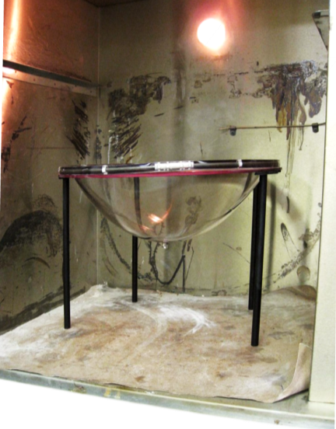
The plastic is ready to pull once it has drooped 1/2 – 1/3 of the model.
Now it’s time to open oven and remove. Grabs the rings!
STEP
6

Slide 16
ALIGN FOR PULL
TIP! Use the spru, which should be pointing towards the bottom of the oven, as a guide when pulling the socket. Make sure you line it up with the center.
STEP
7

Slide 17
Take to model, flip like normal blister forming, pull down with a slight twisting motion and apply vacuum.
Don’t take too long. Be quick this plastic cools very quickly and letting it cool to much will make your pull more difficult.
STEP
8

Slide 18
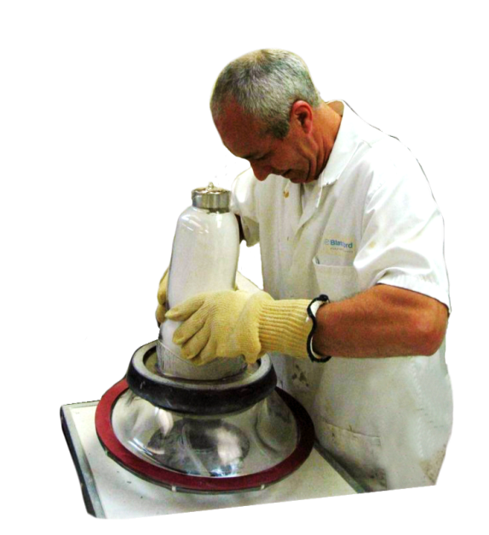
Some hand molding may be required and that is no problem for The Ringmaster®!!

Slide 19
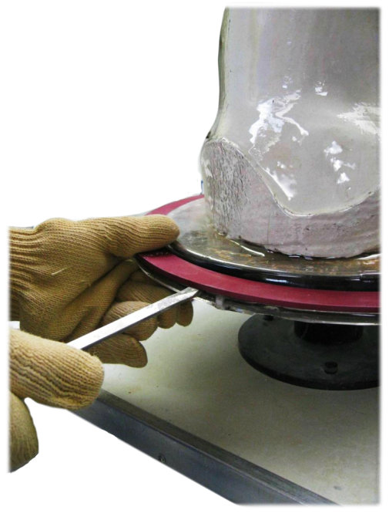
Take a flat head screw driver and place between aluminum support and plastic and create a void. This will allow you to easily separate the plastic from the aluminum ring support when the plastic has cooled.
STEP
9

Slide 20
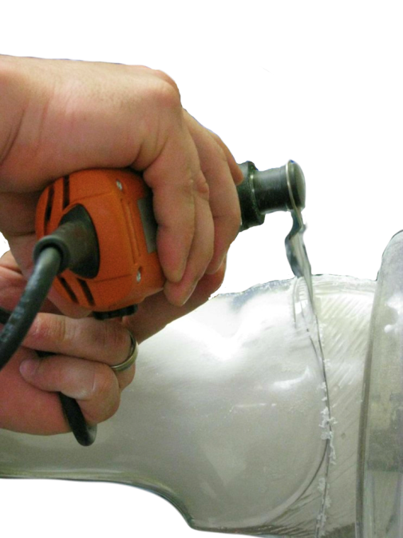
Trim lines and cut out socket.

Slide 21
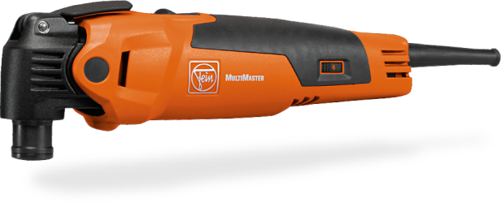
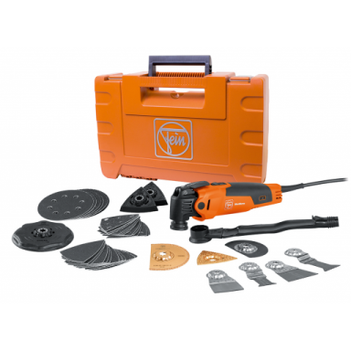
Need a low cost alternative to your expensive cast saw for cutting plastic off of molds?
FEIN MultiMaster. We carry the START 350Q Kit and the TOP 350Q Kit.
Available in pneumatic, or electric. The electric version has the quick change blade option which is shown which saves a lot of time in blade replacement.

Slide 22
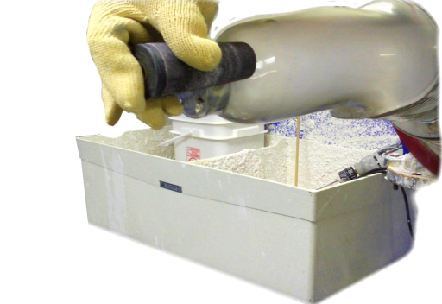
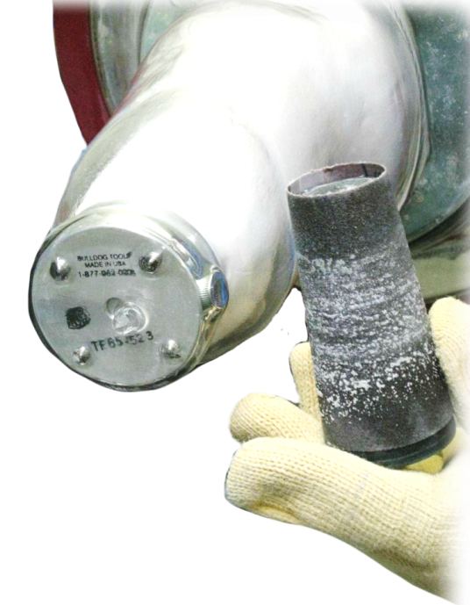
Grind it right!!
Grind across, NOT DOWN. You don’t want to damage the socket so grind across to avoid a disaster.

Slide 23
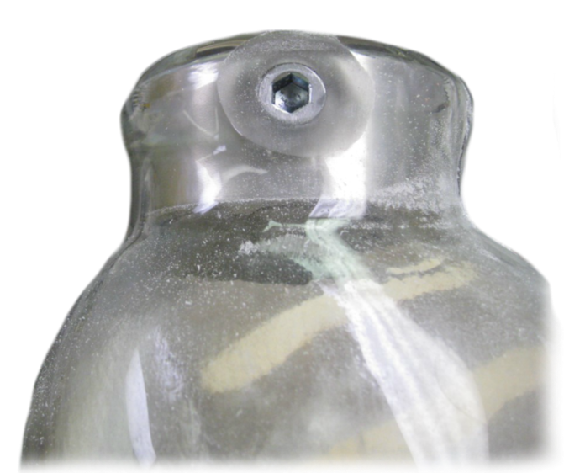
We used the thermoforming dummy with the side bolt (TF-65SB) here.
You simply grind across to the bolt to create your push button hole. Use an Allen wrench to remove the side bolt and the dummy can then be knocked out.

Slide 24
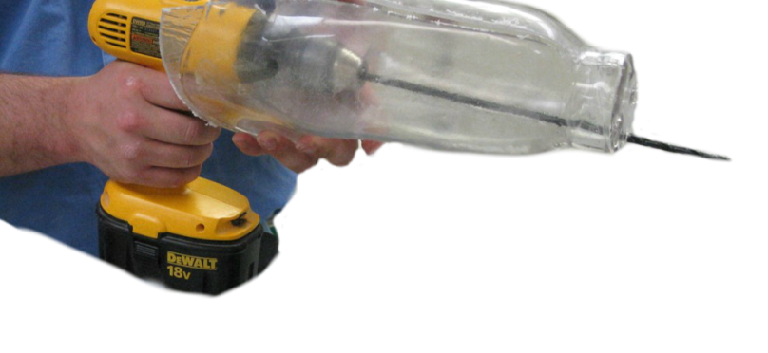
The thermoforming dummy makes it easy to drill out the holes. The thermoforming set screws that were positioned slightly raised gives distinct points for the four hole pattern. No guessing!
Drill out those holes using the long ¼ inch drill bit.

